Slide 1
Survey Feedback on Civil Society Organisation (CSO) Directory
By Mark Palmer, Secretary Civil Society Bahamas
8 March, 2019

Slide 2
BACKGROUND
CURRENTLY THERE IS NO COMPREHENSIVE DIRECTORY OF CSOs
WE DO NOT WHO THE PLAYERS ARE
IT IS HARD TO CONTACT THEM
WE ARE NOT ABLE TO COLLABORATE EFFECTIVELY IN SECTORS
MANY PLAYERS ARE CURRENTLY OPERATING IN SILOS, DUPLICATING WORK

Slide 3
OUR KEY OBJECTIVES
STRENGTHEN THE CIVIL SOCIETY SECTOR BY ENCOURAGING CSOS TO GROUP INTO CLUSTERS AND COLLABORATE WITHIN SECTORS AND CLUSTERS.
STRENGTHEN THE CIVIL SOCIETY SECTOR BY GENERATING AWARENESS OF ITS DIVERSITY AND DEPTH TO POTENTIAL VOLUNTEERS, DIRECTORS AND DONORS.
CREATE A CENTRAL AREA FOR DELIVERING TRAINING RESOURCES, WEBINARS, WORKSHOPS TO CSOS AS WELL AS FUNNELING DONATIONS TO THEM FROM POTENTIAL DONORS.

Slide 4
OUR PLAN
ACTIVITY 1 - SURVEY CSOS TO DETERMINE SPECIFICATION OF REGISTRY
ACTIVITY 2 - RESEARCH FUNCTIONALITY OF REGISTRY
ACTIVITY 3 - PURCHASE ONLINE SOFTWARE AND SET UP REGISTRY FIELDS AND FUNCTIONALITY
ACTIVITY 4 - INPUT DATA INTO REGISTRY
ACTIVITY 5 - BETA TEST REGISTRY
ACTIVITY 6 - LAUNCH TO MEDIA

Slide 5
CSB Survey on a Civil Society Organisation (CSO) Directory
Thursday, March 07, 2019

Slide 6
49
Total Responses
Date Created: Monday, February 25, 2019
Complete Responses: 44

Slide 7
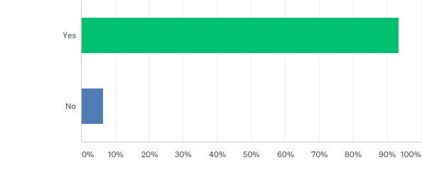
Q1: Do you represent a non profit or Civil Society Organisation (CSO)?
Answered: 47 Skipped: 2

Slide 8
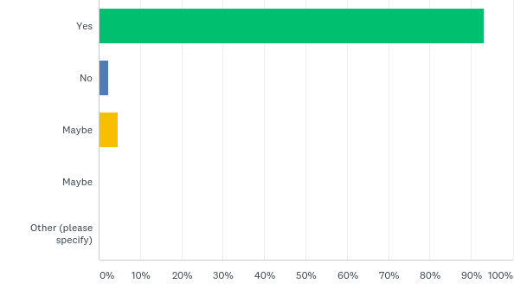
Q2: Would you be in favour of a Directory of CSOs (Non Profit Organisations) in The Bahamas?
Answered: 44 Skipped: 5

Slide 9
Q3: I would like the Directory to be online
Answered: 44 Skipped: 5

Slide 10
Q4: I would like the directory to also be accessible from an app and mobile phone
Answered: 44 Skipped: 5

Slide 11
Q5: I would like to be able to log in and create my CSO account
Answered: 44 Skipped: 5

Slide 12
Q6: I would like to be able to create a profile page for my CSO
Answered: 43 Skipped: 6

Slide 13
Q7: I would like to be able to input my own information on my profile page
Answered: 44 Skipped: 5

Slide 14
Q8: I would like to be able to edit my information on my profile page
Answered: 44 Skipped: 5

Slide 15
Q9: I would like to be able to upload videos to my profile page
Answered: 44 Skipped: 5

Slide 16
Q10: I would like to be able to upload photographs to my profile page
Answered: 43 Skipped: 6

Slide 17
Q11: I would like to be able to list my events on my profile page
Answered: 43 Skipped: 6

Slide 18
Q12: I would like to be able to link my CSO to social media
Answered: 43 Skipped: 6

Slide 19
Q13: I would like visitors to be able to donate to my CSO
Answered: 43 Skipped: 6

Slide 20
Q14: I would like to be able to sell products on my profile page
Answered: 43 Skipped: 6

Slide 21
Q15: I would like visitors to be able to search the Directory by entering a CSO name
Answered: 43 Skipped: 6

Slide 22
Q16: I would like visitors to be able to search the Directory by entering a CSO category or sector
Answered: 43 Skipped: 6

Slide 23
Q17: I would like visitors to be able to message my CSO from their app or mobile phone by clicking a link
Answered: 43 Skipped: 6

Slide 24
Q18: I would like visitors to be able to call my CSO from their app or mobile phone by clicking a link
Answered: 41 Skipped: 8

Slide 25
Q19: I would like to be able to chat with other members in the Directory
Answered: 42 Skipped: 7

Slide 26
Q20: I would like visitors to be able to like and bookmark my CSO
Answered: 42 Skipped: 7

Slide 27
Q21: I would like visitors to be able to write a review about my CSO
Answered: 43 Skipped: 6

Slide 28
Q22: I would like to be able to reply to a visitor's review about my CSO
Answered: 42 Skipped: 7

Slide 29
Q23: I would like visitors to be able to sign up as potential volunteers to my CSO
Answered: 43 Skipped: 6

Slide 30
Q24: I would like visitors to be able to sign up as potential directors to my CSO
Answered: 42 Skipped: 7

Slide 31
Q25: I would like the Directory to protect my information from hacking
Answered: 43 Skipped: 6

Slide 32
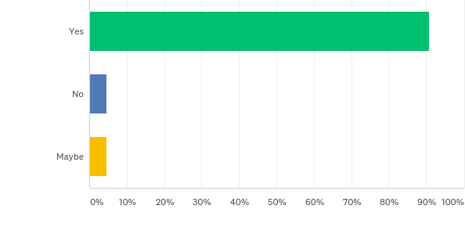
Q26: Would you use the Directory to search information about CSOs?
Answered: 43 Skipped: 6

Slide 33
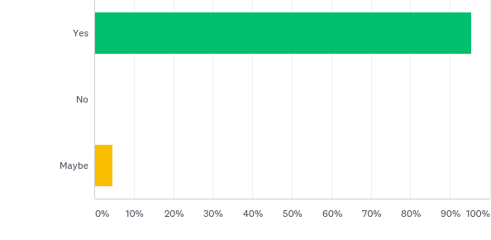
Q27: Would you use the Directory to search which CSOs were working in which sector?
Answered: 43 Skipped: 6

Slide 34
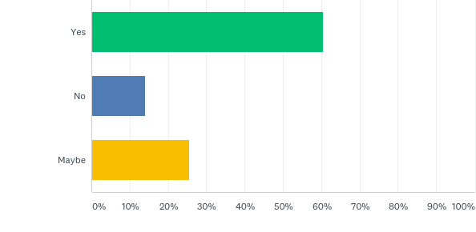
Q28: Would you use the Directory to donate money to CSOs?
Answered: 43 Skipped: 6

Slide 35
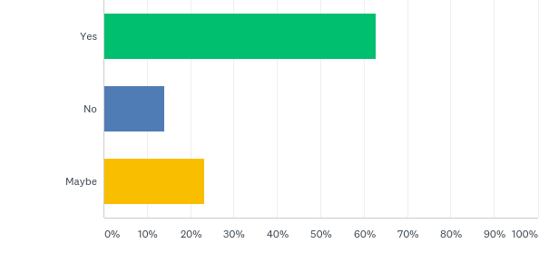
Q29: Would you use the Directory to look for opportunities to volunteeer?
Answered: 43 Skipped: 6

Slide 36
QUESTIONS?

