Slide 1
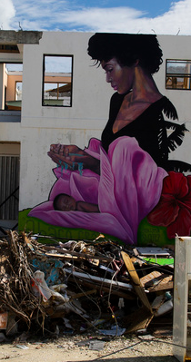
Virtual meeting with the Government of the Bahamas
Tuesday, 10 November 2020
Advancing gender equality in environmental migration and disaster displacement in the Caribbean
Introduction:
Amelia Bleeker, Associate Programme Management Officer and Gender Focal Point, ECLAC subregional headquarters for the Caribbean
Dr. Jacinta Higgs, Director, Department of Gender & Family Affairs, Ministry of Social Services & Urban Development, Government of the Bahamas
Presenters:
Briana Mawby, Lead Researcher, IOM
Amelia Bleeker, Associate Programme Management Officer and Gender Focal Point, ECLAC subregional headquarters for the Caribbean
Pablo Escribano, Regional Thematic Specialist on Migration, Environment and Climate Change, IOM

Slide 2
Virtual meeting with the Government of the Bahamas
Tuesday, 10 November 2020
Advancing gender equality in environmental migration and disaster displacement in the Caribbean
Agenda:
Welcome remarks and introduction
Overview and presentation of the study
Discussion on the presentation and study
Closure of the meeting

Slide 3
Gender, Disaster Displacement and Environmental Migration in the Caribbean
Geographic and gender context:
The Caribbean is highly vulnerable and prone to a range of natural hazards.
The impacts of disaster displacement and environmental migration are inherently linked to socioeconomic status, which is gendered.
Notes:
<number>

Slide 4
Gender, Disaster Displacement and Environmental Migration in the Caribbean
Human mobility in the Caribbean:
Migration is shaped by economic and labour market drivers.
Migration may be a choice that saves lives and livelihoods.
Leveraging international and regional frameworks for migration is key.
Notes:
<number>

Slide 5
Case study on the gendered impacts of disaster displacement in the Bahamas
Methodology:
Review of secondary data sources
Data requests to government officials and regional organisations
Notes:
<number>

Slide 6
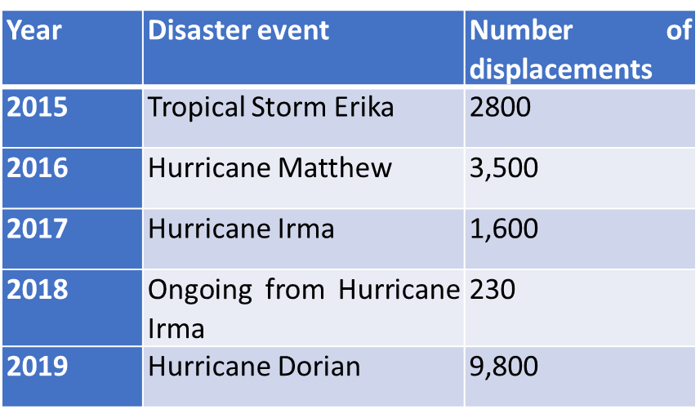
The gendered impacts of Hurricane Dorian in the Bahamas
Displacement in the Bahamas and the impacts of Hurricane Dorian
Disaster displacement in the Bahamas has become a yearly occurrence
Dorian’s official death toll: 74 persons
Actual figure likely higher
Approximately 9,800 displacements
USD$2.5 billion damage
Disaster-induced displacements in the Bahamas 2015-2019
Source: IDMC, 2020
Notes:
<number>

Slide 7
The gendered impacts of Hurricane Dorian in the Bahamas
Gender inequality and GBV in the Bahamas
UN Special Rapporteur on violence against women (VAW), its causes and consequences found that VAW is “widespread, largely perceived as a private matter and accepted as normal” in the Bahamas
Highest recorded rape rates in the Caribbean, although there is widespread underreporting
Migrant women and women of Haitian descent are at particular risk
Violence against the LGBTI community also endemic
Girls outperform boys in education, but women experience higher unemployment and a 33% gender pay gap (2019)
Low political participation levels
Discriminatory nationality laws
Notes:
<number>

Slide 8
The gendered impacts of Hurricane Dorian in the Bahamas
Gendered impacts of displacement from Hurricane Dorian
Women were displaced in larger numbers than men from Grand Bahama and Abaco, especially Grand Bahama (70%)
However, more people evacuated from Abaco overall
Women and girls were more adversely impacted by poor living conditions and protection issues in emergency shelters following Hurricane Dorian
Emergency shelters fell short of Sphere Standards
Only some shelters collected sex- and age-disaggregated information on their populations
Notes:
<number>

Slide 9
The gendered impacts of Hurricane Dorian in the Bahamas
Gendered impacts of displacement from Hurricane Dorian
Vulnerable groups, including Haitian and female-headed households, were likely to stay longer in temporary accommodations
Women were less able to return to their communities of origin and recover from financial losses following Hurricane Dorian
More limited access to financial resources and skills for reconstructing homes
Lower levels of property ownership
Security concerns
Notes:
<number>

Slide 10
The gendered impacts of Hurricane Dorian in the Bahamas
Dorian’s disproportionate impact on persons of Haitian descent
The Abaco population was particularly vulnerable to disaster displacement following Hurricane Dorian due to its large Haitian community
Poor living conditions of the Haitian population prompted disproportionate displacement numbers compared to general population
Haitian feared entering emergency shelters due to discrimination and deportation risk
‘Illegal immigrants’ not welcome in government shelters and deportations took place a month after the disaster
Heightened barriers to return to pre-Dorian communities due to risk of family separation, more limited social contacts, security/GBV concerns, and threats of deportation
Notes:
<number>

Slide 11
The gendered impacts of Hurricane Dorian in the Bahamas
Conclusion
Gender is not currently mainstreamed or given special consideration in climate change or disaster risk reduction laws or policies in the Bahamas
Draft National Equality Equity Policy Action Plan (NEEPAP) calls for a review
Although women experienced the most barriers to disaster recovery, they protected and cared for children and elderly persons and managed the return of their households to pre-Dorian communities, usually with fewer resources than men
Women of Haitian descent displayed particular resilience in meeting the care and protection needs of families, while rebuilding their lives in new communities and islands amidst marginalization and insecurity
Notes:
<number>

Slide 12
Findings and recommendations
Gender is a fundamental factor for understanding climate migration and disaster displacement
“Traditional gender structures and roles not only amplify the particular vulnerabilities of women and girls, indigenous persons, and LGBTI persons in times of crisis or transition, but also determine access to resources in communities of origin, during migration, in the temporary or long-term destination and in potential return processes.”
“The impacts of climate change are often gender-determined, as limited access to resources, to the labour market and to decision-making power tends to affect resilience and coping capacities.”
“The situation of women and girls as internal migrants, notably to cities, remains under-addressed across the Caribbean.”

Slide 13
Findings and recommendations
2. Disaster situations, displacement and temporary accomodations require gender-responsive interventions
“Disasters amplify pre-existing marginalization and create obstacles to rebuilding lives or finding durable solutions for displacement.”
“Limitations in emergency shelter standards, vulnerability to GBV and security concerns in displacement scenarios compound the gender-differentiated impacts of disaster displacement.”

Slide 14
Findings and recommendations
3. Limited access to resources and opportunities influences gender-specific vulnerabilities and capacities to return to communities of origin after displacement
“Mitigating or eliminating the impact of gender inequality on access to resources is key to preventing forced or involuntary migration. This includes the capacity of women and girls to access livelihoods to ensure their wellbeing and the resources required to build resilience.”
“Post disaster assessments in countries such as the Bahamas and Dominica also show that returning to the communities of origin is also more difficult for women and girls.”

Slide 15
Findings and recommendations
4. Gender-based violence is a critical issue to be addressed in environmental migration and disaster situations
“GBV is a prevalent threat to women and girls in areas of origin and through the mobility continuum… GBV has been described as a pervasive concern and a major public health issue, which requires strong policymaking and public interventions.”
“Vulnerability to GBV also heightens women and girls’ risks in situations of extreme weather events and climate change.”
“GBV may be especially prevalent in displacement shelters and temporary accommodations. This may be due to limited attention to gender-sensitive protection needs and design considerations.”

Slide 16
Findings and recommendations
5. Improved evidence and data are required to facilitate gender-responsive policy-making
“Further evidence is required on different aspects of the migration, environment and climate change nexus. In particular, the case studies of Jamaica and Cuba put into perspective the limited information available on the drivers, trends and patterns of internal migration and their relation to environmental degradation and climate change.”
“Gender disaggregation of statistics on displacement and other disaster impacts is also crucial to highlight inequalities between women and men before, during and after disaster situations.”
“There are opportunities to mainstream gender indicators in post-disasters assessments and in environmental and climate impact assessments relevant to human mobility.”

Slide 17
Findings and recommendations
6. Create opportunities to promote and recognize women’s knowledge, empowerment and leadership
“As women often play a central role in creating inclusive community structures in the Caribbean, their involvement in disaster preparedness and response management is a key factor to prevent harm and losses. Examples of countries with women in management positions and community organizations demonstrate the positive impact of these trends.”
“It is critical to understand gender-based vulnerabilities to inform gender-responsive disaster prevention, response, and recovery processes. However, these processes should also support the ways in which women are already acting as leaders in their families and communities.”

Slide 18
Findings and recommendations
7. Specific policies are still required on the gender aspects of climate migration in slow-onset scenarios
“Evidence and policy responses are still missing with regards to the gendered dimensions of slow-onset environmental migration. On one side, gender integration in climate and disaster policies is nascent and, on the other, climate policies also barely incorporate mobility elements. As a result, actual gender considerations in environmental migration strategies are non-existent.”
“Existing subregional cooperation systems … offer potential avenues to develop a networked approach to disaster and climate resilience. These agreements have been used in the past to facilitate the mobility of persons affected by natural hazards.”

Slide 19
Findings and recommendations
8. The situation of specific groups requires attention to account for multiple, compounded vulnerabilities
“As documented in this study, people may experience multiple layers of vulnerability, and gender-based discrimination may interact with other forms of marginalization, such as irregular migration status or lack of access to resources. Persons with disabilities, indigenous populations, LGBTI persons, migrants with irregular status, and other vulnerable groups are especially impacted by disaster and climate shocks and experience poorer recovery outcomes.”
“Considerations for the LGBTI community and non-binary people are largely absent from climate and mobility strategies in the Caribbean.”

Slide 20
Findings and recommendations
Gender-responsive disaster risk reduction, recovery and response to address displacement
Ensure gender-responsive design, construction and management of emergency shelters and other temporary accommodations in accordance with the Sphere Standards;
Addressing the protection needs of cross-border displaced migrants from a gender perspective;
Mainstreaming gender into livelihoods training, reconstruction assistance and other support for people and communities that are displaced or evacuated for long periods of time;
Promoting stronger involvement of women and other groups with specific needs, such as indigenous and LGBTI persons, in disaster risk reduction management but also in climate change adaptation and urban planning departments.

Slide 21
Findings and recommendations
Gender-responsive climate migration policies, planning and responses
Advancing efforts to better map and understand the gender implications of climate migration in slow onset processes, such as those related to sea level rise, coastal erosion and land degradation;
Addressing specific gender vulnerabilities in climate sensitive economic sectors, such as agriculture and tourism;
Advancing action on the situation of women migrants in urban centers;
Tackling the impacts of climate migration on gendered division of labour and women’s disproportionate caregiving responsibilities;
Using positive language recognizing women and men’s capacity to be active agents in pursuing disaster recovery outcomes and climate mitigation and adaptation responses

Slide 22
Findings and recommendations
Improving the availability and use of gender-disaggregated data on disaster displacement and climate migration
Building the capacities of national stakeholders to collect, analyse and utilise gender-disaggregated data in disaster and climate migration situations for evidence-based policy making;
Mainstreaming gender disaggregation in disaster preparedness and response information collection and processing with the integration of specific needs and factors relating to resilience;
Improving evidence on GBV at all stages of the mobility continuum;
Implementing policies and systems to ensure privacy standards and protection of sensitive data on migrant and displaced persons;
Leveraging existing frameworks and initiatives to harmonize data collection mechanisms on the gender dimensions of environmental migration and disaster displacement;
Promoting synergies with research institutions that have advanced the study of climate migration and disaster displacement in the Caribbean and are at the forefront of the integration of gender considerations into data collection and analysis
Further research opportunities to identify the specific needs of women and girls in climate migration and disaster displacement contexts and address data gaps

